Slide 1
7Relational Database Design
Relational Database Design using ER to Relational Mapping; Informal Design Guidelines for Relational Schemas, Functional Dependencies; Normal Forms Based on primary keys; General Definitions of Second and Third Normal Forms; Boyce Codd Normal; Multivalued Dependency and Fourth Normal Form; Properties of Relational Decomposition

Slide 2
Mapping ER Model to Relational Model
ER model provides a conceptual model of the real world concepts, which is represented in database.
ER model is mapped to the relational model by representing ER database schema by a collection of relation schemas.
The mapping from ER model to relational model is possible due to the reason that both the models represent the real world logically and follow similar design principles.
After designing the ER diagram of systems, we need to convert it to Relational models which can directly be implemented by the RDBMS like oracle, MySQL etc.

Slide 3
Mapping ER Model to Relational Model
To reduce given ER into table we create a table for each entity set and for each relationship set and assign the name of the corresponding entity set or relationship set as table name.
Generally the number of attributes of an entity set or relationship set equal to the degree of a corresponding table. To reduce given ER diagram into tables normally we divide ER diagram into following section.
Mapping strong entity sets to ER
Mapping weak entity sets to ER
Mapping relationship sets to ER
Mapping multivalued attributes to ER
Mapping composite attributes to ER
Mapping of N-ary relationship types to ER
Mapping specialization/generalization to ER
Mapping Aggregation to ER
1-<number>

Slide 4
Mapping Strong Entity Sets
An entity set is mapped to a relation in a straightforward way.
Each simple attribute of the entity set becomes an attribute of the table and primary key of the entity set becomes primary key of the relation.
Example: Entity set Book can be represented in relation as below:

Slide 5
Mapping Strong Entity Sets
Category
ISBN
Title
Book
Year
Price
Pages

Slide 6
Mapping Strong Entity Sets
ISBN | Title | Category | Price | Pages | Year

Slide 7
Mapping Composite and Multivalued Attributes
If an entity has composite attributes, no separate attribute(column) is created for composite attribute itself rather attributes (columns) are created for each component attributes of the composite attribute.
For multivalued attribute, separate relation is created with primary key of the entity set and multivalued attribute itself.

Slide 8
Mapping Composite and Multivalued Attributes
District
Aid
Address
Home-Town
Author
AName
Email

Slide 9
Mapping Composite and Multivalued Attributes
Aid | AName | District | Home-Town
Aid | Email

Slide 10
Representing Weak Entity Sets
A weak entity set does not have its own primary key and always participates in one to many relationship with owner set and has total participation.
For a weak entity set create a relation that contains all simple attributes (or simple components of composite attributes).
In addition, relation for weak entity set contains primary key of the owner entity set as foreign key and its primary key is formed by combining partial key (discriminator) and primary key of the owner entity set

Slide 11
Representing Weak Entity Sets
-
Edition-no
ISBN
Title
Type
Category
Book
Has
Edition
Price
Year
Pages

Slide 12
Representing Weak Entity Sets
ISBN | Edition-no | Type

Slide 13
Representing Binary One –to One Relationship sets
For a binary one to one relationship set separate relation is not created rather primary key of an entity set is included in relation for another entity set as a foreign key.
It is better to include foreign key into the entity set with total participation in the relationship.
Note: If the relationship set has its own attribute, separate relation is created for relationship sets also.

Slide 14
Representing Binary One –to One Relationship sets
Uname
ESTD
RName
Age
University
Has
Rector
Type
Location
Sex

Slide 15
Representing Binary One –to One Relationship sets
UName | ESTD | Type | Location
RName | Uname | Age | Sex

Slide 16
Representing One to Many Relationship
For binary one-to-many relationship identify the relation that represent the participating entity type at the N-side of the relationship type and then include primary key of one side entity set into many side entity set as a foreign key.
Separate relation is created for the relationship set only when the relationship set has its own attribute.

Slide 17
Representing one to Many Relationships
1 N
PName
PID
Title
Price
publishes
publisher
Book
ESTD
City
Pages
ISBN

Slide 18
Representing one to Many Relationships
Pid | Pname | ESTD | City
ISBN | Title | Price | Pages | Pid

Slide 19
Representing Many to Many Relationships
For a binary many to many relationship type, separate relation is created for the relationship type.
Primary key for each participating entity set is included as foreign key in the relation and their combination will form the primary key of the relation.
Besides this, simple attributes of the many-to many (or simple components of composite attributes) relationship type is included as attributes of the relation

Slide 20
Representing Many to Many Relationship
M N
Email
AName
Aid
Title
Price
ISBN
Review
Author
Book
Rating
Address
Pages
Year

Slide 21
Representing Many to Many Relationship
ISBN | Title | Pages | Price | year
Aid | Aname | Email | Address
ISBN | Aid | Rating

Slide 22
Representing N-ary Relations
For each n-ary relationship set for n>2, a new relation is created.
Primary key of all participating entity sets are included in the relation as foreign key attributes.
Besides this all simple attributes of the n-ary relationship (or simple components of composite attributes ) are included as attributes of the relation

Slide 23
Representing N-ary Relations
SName
Location
Sid
UName
Enrolls
Student
University
ESTD
Level
Course
Credit
CName
Cid

Slide 24
Representing N-ary Relations
Sid | SName | Level
UName | ESTD | Location
Cid | SName | Level
Sid | UName | Cid

Slide 25
Representing Specialization/Generalization
Two approaches
A relation is created for higher level entity set and then separate relation is created for each relation and primary key of super class is added to all subclass relation
Another approach is to create relations only for lower level entity sets. Here, relation for a subclass entity set included all attributes of super-class entity set and all of its own attributes. This approach is possible only when subclasses are distinct and complete.

Slide 26
Representing Specialization/Generalization
Title
Pages
ISBN
Book
Prices
Author
Year
o
Subject
Type
Text Book
Language
Novel
Language

Slide 27
Representing Specialization/Generalization
ISBN | Title | Author | Pages | price | Year
ISBN | Subject
ISBN | Language
ISBN | Type

Slide 28
Informal Design Guidelines for Relational Schema
Informal guidelines that may be used as measures to determine the quality of relation schema design are listed below:
Making sure that the semantics of the attributes is clear in schema.
Reducing the redundant information in tuples
Reducing the NULL values in tuples
Disallowing the possibility of generating spurious tuples.

Slide 29
Making sure that the semantics of the attributes is clear in schema.
Whenever we are going to form relational schema there should be some meaning among the attributes. This meaning is called semantics. The semantics relates one attribute to another with some relation.
Guidelines:
Informally, each tuple in a relation should represent one entity or relationship instance
Attributes of different entities (relations) should not be mixed in the same relation.
Entity and relationship attributes should be kept apart as much as possible

Slide 30
Reducing the redundant information in Tuples
If a table containing attributes of multiple entities may cause redundant information problems. Information is stored redundantly wasting storage.
We can reduce redundant information problem by using normalization.
Normalization is the process of reducing a single table into multiple tables.

Slide 31
Reducing the NULL values in tuples
In some schema designs we may group many attributes together into a “fat” relation. If many of the attributes do not apply to all tuples in the relation, we end up with many NULLs in those tuples.
This can waste space at the storage level and may also lead to problems with understanding the meaning of the attributes and with specifying JOIN operations at the logical level.
Another problem with NULLs is how to account for them when aggregating operations such as COUNT or SUM are applied.

Slide 32
Functional Dependencies
Functional dependencies are the relationships among the attributes within a relation.
Let A and B are attributes of a relation R. If each value of B is associated with exactly one value of A then B is said to be functionally dependent on A. It is denoted by A→B. The meaning of this notation is “A” determines “B” or “B” is functionally dependent on “A”.
Here “A” is called determinant and “B” is called object of the determinant

Slide 33
Functional Dependency
Functional dependency A→B holds if whenever two tuples have the same value for A, they must have the same value for B.
For any two tuples t1 and t2 in any relation instance r(R)
If t1[A] = t2[A] then t1[B] = t2[B]

Slide 34
Example
Student (Sid, SName, address, age)
Here, SName, address and age are functionally dependent on sid.
Meaning is that each student id uniquely determines the value of attributes of student.
This can be expressed as:
Sid→SName
Sid→address
Sid→age

Slide 35
Types of Functional Dependency
Fully Functional Dependency
Partial Functional Dependency
Trivial Functional Dependency
Transitive Functional Dependency
Multivalued Dependency

Slide 36
Fully Functionally Dependency
An attribute is fully Functionally Dependent on a second attribute if and only if it is functionally dependent on the second attribute but not on any subset of the second attribute.
Mathematically, for a relation schema R, in a functional dependency X→Y, Y is said to be fully functional dependency on X if Z→Y is false for Z ⊂ X

Slide 37
Partial Functional Dependency
An attribute is partial functional dependent on a second attribute if and only if it is functionally dependent on second attribute and also dependency occurs on any subset of the second attribute.
Mathematically, for a relation schema R, in a functional dependency X→Y, Y is said to be fully functional dependency on X if Z→Y if true for some Z ⊂ X

Slide 38
Transitive Dependency
A transitive dependency exists when there is an intermediate functional dependency.
Notation: A→B, B→C, then A→C.
Here we have transitive dependency

Slide 39
Trivial and Non-trivial Dependency
A functional dependency X→Y is said to be trivial dependency if Y is subset of X.
The functional dependency that is satisfied by all the relations is called trivial functional dependency.
For example: A→A is trivial functional dependency.
If functional dependency is not trivial then it is non- trivial functional dependency

Slide 40
Multivalued Dependency
Multivalued dependency occurs when there are more than one independent multivalued attributes in a table.
For a dependency x → y, if for single value of x, multiple value of y exists, then the relation have multivalued dependency.
The relation should have at least three attributes That is R(x , y , z) and if x->->y and x->->z
And y and z are independent of each other
For example consider the following example:
1-<number>

Slide 41
Multivalued Dependency
Ename | Project_name | Dname
Ram | DBMS | Sita
Ram | JAVA | Koshila
Ram | DBMA | Koshila
Ram | Java | Sita
Here we have following multivalued dependency
Ename->->Project_name
Ename->->Dname
1-<number>

Slide 42
Functional Dependency Inference Rules(Armstrong’s Axioms)
Reflexivity: If Y ⊆ X then X→Y
Augmentation: If X→Y and Z is a subset of R then XZ→YZ.
The augmented rule alone can be expressed as:
X→Y then ZX→Y
Transitivity: If X→Y and Y→Z then X→Z

Slide 43
Functional Dependency Inference Rules(Armstrong’s Axioms)
Pseudo Transitivity: If X→Y and YW→Z then XW→Z
Union: If X→Y and X→Z then X→YZ
Decomposition: If X→YZ then X→Y and X→Z

Slide 44
Problems without Normalization
If a table is not properly normalized and has data redundancy then it will not only eat up extra memory space but will also make it difficult to handle and update the database, without facing data loss.
Insertion, deletion, updating anomalies are very frequent if database is not normalized.
To understand this, let us take the example of a student table.

Slide 45
Problems without Normalization
Sid | Sname | Branch | HOD | Office_Phone
100 | Kamal | Pokhara Branch | Mr Suman | 4455661
101 | Aman | Pokhara Branch | Mr Suman | 4455661
102 | Bimal | Pokhara Branch | Mr Suman | 4455661
103 | Himal | Pokhara Branch | Mr Suman | 4455661
104 | Aarav | Banepa Branch | Mr Dinesh | 3344551
105 | Ramesh | Banepa Branch | Mr Dinesh | 3344551
In this table, we see that data for the
Field branch, HOD and office_phone is
Repeated for students who are in the same
Branch in the college. This is Data Redundancy

Slide 46
Problems without Normalization
Insertion Anomaly: suppose that for a new admission, until and unless a student opts for a branch, data for the student cannot be inserted, or else we will have to set the branch information as NULL.
Also, if we have to insert data of 100 students of same branch, then the branch information will be repeated for all those 100 students.

Slide 47
Problems without Normalization
Update Anomaly: What if, Dinesh leaves the college?. In that case, all the student records will have to be updated. This is update anomaly

Slide 48
Problems without Normalization
Deletion Anomaly: In our table, two different information are kept together, student information and branch information.
Hence, at the end of the academic year, if student records are deleted, we will also lose the branch information. This is deletion anomaly

Slide 49
Normalization
The process of decomposing unsatisfying “bad” relations by breaking up their attributes into smaller relations is called normalization
Normalization allows us to minimize insert, update, and delete anomalies and help maintain data consistency in the database

Slide 50
Purpose of Normalization
To avoid redundancy by storing each fact within the database only once
To put data into the form that is more able to accurately accommodate change
To avoid certain updating “anomalies”
To facilitate the enforcement of data constraint
To avoid unnecessary coding

Slide 51
Types of Normalization
First Normal Form (1 NF)
Second Normal Form(2 NF)
Third Normal Form (3 NF)
Boyce Codd Normal Form(BCNF)
Fourth Normal Form (4 NF)
Fifth Normal Form (5 NF)

Slide 52
Steps in Normalization
Unnormalized Form
Remove repeating Groups
First Normal Form (1 NF)
Remove partial Dependencies
Second Normal Form (2 NF)
Remove Transitive Dependencies
Third Normal Form (3 NF)
Remove remaining Functional dependencies
Boyce Code Normal Form (BCNF)
Remove multivalued Dependency
Fourth Normal Form (4 NF)
Remove remaining Anomalies
Fifth Normal Form (5 NF)

Slide 53
First Normal Form
A relation is said to be in 1 NF if it does not have multi-valued attributes, composite attributes and their combinations.
It states that the domain of an attribute must include only atomic (simple invisible) values

Slide 54
Example (Table not in 1 NF)
Sid | SName | Subjects
 |  | Subject1 | Subject2
1 | Nitesh | DBMS | Graphics
2 | Laxman | C | C++
3 | Geeta | Java | .NET
4 | Anisha | Simulation | SAD
5 | Monika | Algebra | Calculus

Slide 55
Table in 1 NF
Sid | SName | Subject1 | Subject2
1 | Nitesh | DBMS | Graphics
2 | Laxman | C | C++
3 | Geeta | Java | .NET
4 | Anisha | Simulation | SAD
5 | Monika | Algebra | Calculus

Slide 56
Table(Not in 1 NF)
Sid | SName | Address | Phone_no
1 | Nitesh | Kathmandu | 9841496321, 9841496322
2 | Laxman | Nepalganj | 9841496323, 9841496324
3 | Geeta | Dhangadhi | 9841496325, 9841496326
4 | Anisha | Pokhara | 9841496327, 9841496328
5 | Monika | Lalitpur | 9841496329, 9841496330

Slide 57
Table in 1 NF
Sid | SName | Address
1 | Nitesh | Kathmandu
2 | Laxman | Nepalganj
3 | Geeta | Dhangadhi
4 | Anisha | Pokhara
5 | Monika | Lalitpur

Slide 58
Table int 1 NF
Sid | Phone_No
1 | 9841496321
1 | 9841496322
2 | 9841496323
2 | 9841496324
3 | 9841496325
3 | 9841496326
4 | 9841496327
4 | 9841496328
5 | 9841496329
5 | 9841496330

Slide 59
Second Normal Form (2 NF)
A relation is said to be in 2 NF if and only if
It is already in 1 NF and
Every non-prime attribute is fully dependent on the primary key of the relation

Slide 60
Example1: Suppose a school wants to store the data of teachers and the subjects they teach. Since a teacher can teach more than one subjects, the table can have multiple rows for a same teacher.
Tid | TSubjects | Tage
111 | Maths | 38
111 | Physics | 38
222 | Biology | 39
333 | Physics | 40
333 | Chemistry | 40
Candidate key :{Tid,Tsubject}
Non Prime Attribute: Tage

Slide 61
The table is in 1 NF because each attribute has atomic values. However, it is not in 2 NF because non-prime attribute Tage is dependent on Tid along which is a proper subset of candidate key.
This violates the rule for 2NF as the rule says, “no non-prime attribute is dependent on the proper subset of any candidate key of the table”.
To make the in 2NF we can break it in two tables as below
Tid | TSubjects
111 | Maths
111 | Physics
222 | Biology
333 | Physics
333 | Chemistry
Tid | Tage
111 | 38
222 | 39
333 | 40
Now the tables are in 2NF

Slide 62
Example 2: Employee-department Table
Emp-Id | Emp-Name | Emp-Salary | Dept-No | Dept-Name
1 | Keshav | 40000 | D1 | BBA
1 | Keshav | 40000 | D2 | CSIT
2 | Asmita | 30000 | D3 | BBS
3 | Birendra | 60000 | D2 | CSIT

Slide 63
Employee-department Table
In the above (Emp-Id, Dept-No) is the primary key.
Emp-Name, Emp-Salary, Dept-Name all depends upon (Emp-Id, Dept-No).
Again Emp-Id→Emp-Name, Emp-Id→Emp-Salary and Dept-No→Dept-Name. Thus, there also occurs partial dependency. Hence this relation is not in 2 NF
Now converting this relation into 2NF by decomposing this relation into three relations as

Slide 64
Table in 2NF
Emp-Id | Emp-Name | Emp-Salary
1 | Keshav | 40000
2 | Asmita | 30000
3 | Birendra | 60000

Slide 65
Table in 2 NF
Dept-No | Dept-Name
D1 | BBA
D2 | CSIT
D3 | BBS

Slide 66
Table in 2 NF
Emp-Id | Dept-No
1 | D1
1 | D2
2 | D3
3 | D2

Slide 67
Third Normal Form
A relation is said to be in third normal form if and only if:
It is already in 2 NF and
Every non-prime attribute is non-transitively dependent on the primary key
Inversely: If a table contains transitive dependency then it is not in 3 NF

Slide 68
Example: Student table
Sid | SName | Age | Sex | Hostel_Name
1 | Laxmi | 21 | Female | White-House
2 | Binita | 22 | Female | White-House
3 | Rajesh | 32 | Male | Red-House
4 | Aayan | 21 | Male | Red-House

Slide 69
Third Normal Form
Here, Sid→Sname , Sid → Age , Sid→Sex, Sid→Hosel-Name.
Also Sex→Hostel-Name.
Transitive dependency.

Slide 70
Table in 3 NF
Sid | SName | Age | Sex
1 | Laxmi | 21 | Female
2 | Binita | 22 | Female
3 | Rajesh | 32 | Male
4 | Aayan | 21 | Male

Slide 71
Table in 3 NF
Sex | Hostel-Name
Female | White-House
Male | Red-House

Slide 72
Boyce Codd Normal Form(BCNF)
It is an advance version of 3NF. It is stricter than 3NF. A table complies with BCNF if it is in 3NF and for every functional dependency X→Y, X should be the super key of the relation
A relation R is said to be in BCNF with respect to all the functional dependencies of the form α→β where α ⊆R and β ⊆R, if at least one of the following holds
α→β is a trivial functional dependency (β ⊆ α)
α is a candidate key for schema R
Simply a relation R is in BCNF if and only if, every determinant is a candidate key

Slide 73
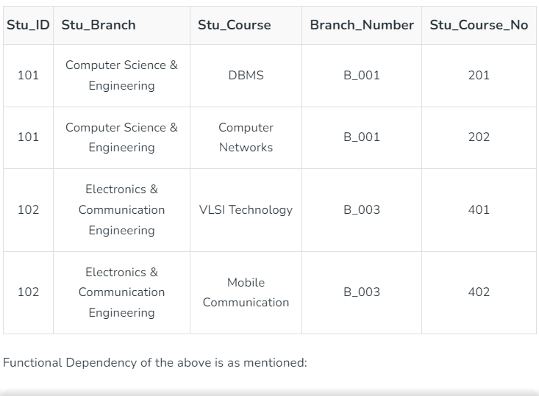

Slide 74
BCNF and Third Normal Form
All BCNF are in 3NF but not all 3NF are in BCNF
BCNF does not make any reference to the concepts of full or partial dependencies.
BCNF is stronger form of normalization than 3NF because it eliminates the second condition for 3NF, which allows the right side of the FD to be a prime attribute.
Thus, every left side of a FD in a table must be a candidate key

Slide 75
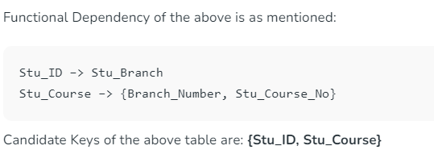
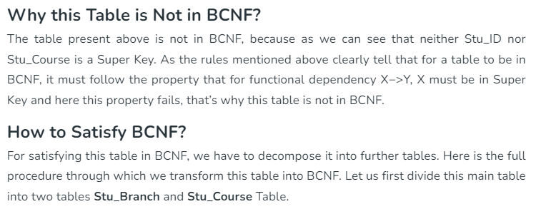

Slide 76
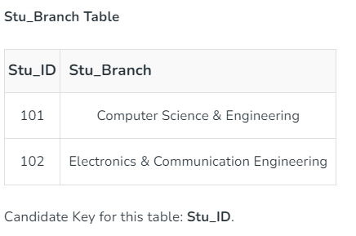

Slide 77


Slide 78
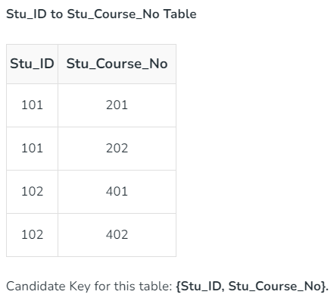
78

Slide 79
Fourth Normal Form
A relation R is in fourth normal form if and only if it satisfied following two conditions simultaneously
R is already in BCNF or in 3NF
If it contains no multi-valued attributes

Slide 80
Table not in 4 NF
Course-Id | Instructor | Text-Book
MGS404 | Clay | Hansen
MGS404 | Clay | Kroenke
MGS404 | Drake | Hansen
MGS404 | Drake | Kroenke

Slide 81
Tables in 4 NF
By placing the multivalued attributes in tables by themselves, we can convert the above table to 4NF
Course-Id | Instructor
MGS404 | Clay
MSG404 | Drake
Course-Id | Text-Book
MSG404 | Hansen
MSG404 | Kroenke

Slide 82
Decomposition
Decomposition is the process of breaking down in parts. It replaces a relation with a collection of smaller relations. It should be always be lossless, because it conforms that the information in the original relation can be accurately reconstructed based on the decomposed relations.
1-<number>

Slide 83
Lossless Decomposition
The condition hold for the decomposition to be lossless if the natural join of decomposed relations of a given relations must be same as that of original relation.
Properties of relational decomposition
Lossless decomposition
Dependency Preservation
Lack of Data Redundancy

Slide 84
Lossless Decomposition
Decomposition must be lossless. It means that the information should not get lost from the relation that is decomposed. It gives a guarantee that the join result in the same relation as it was decomposed.
1-<number>

Slide 85
Lossless Decomposition
R
A | B | C
1 | p | a
2 | q | b
3 | r | c
R1
R2
B | C
p | a
q | b
r | C
A | B
1 | p
2 | q
3 | r

Slide 86
R1 natural join R2
B | C
p | a
q | b
r | C
A | B
1 | p
2 | q
3 | r
R1
R2
A | B | C
1 | p | a
2 | q | b
3 | r | c
R

Slide 87
Closure of set of Functional Dependencies
It is not sufficient to consider given set of functional dependencies.
We need to consider all functional dependencies that hold.
We shall see that, given a set of F of functional dependencies, we can prove that certain other functional dependencies hold.
We say that such functional dependencies are “logically implied by F.
In brief, the set of dependencies that can be logically implied by F is called the closure of F and its closure is written as F⁺

Slide 88
Closure of set of Functional Dependencies
We can find all of F⁺ by applying Armstrong’s axioms
If A⊆B then B→ A (reflexive )
If A→ B then AC→ BC (Augmentation)
If A→B and B→C then A→C (Transitive)
If A→B holds and A→C holds then A→BC (Union Rule)
If A→BC holds then A→B and A→C (Decomposition Rule)
If A→B holds and CB→D holds then AC→D holds (Pseudo Transitivity)

Slide 89
Algorithm to compute closure of set of functional dependencies
F⁺ = F
repeat
  for each functional dependency f in F⁺
  apply reflexivity and augmentation rules on f
  add the resulting functional dependencies on F⁺
  for each pair of functional dependencies f₁ and f₂ in F⁺
  if f₁ and f₂ can be combined using transitivity
  add the resulting functional dependency to F⁺
  Until F⁺ does not change any further

Slide 90
Example 1
Let R = (A,B,C,D)
F = {A→B,A→C,BC→D}
List several members of F⁺
Solution: Since A→B and A→C then A→BC (Union rule)
Since A→BC, BC→D then A→D (Transitivity)
Since A→C, BC→D then AB→D (By pseudo transitivity rule)
Hence F⁺ = {A→A,B→B,C→C,D→ D,A→B,A→C,BC→D,A→BC,A→D,AB→D)

Slide 91
Example 2
Let R = (A,B,C,G,H,I) and F = {A→B,A→C,CG→H,CG→I,B→H) Compute closure of F(F⁺)
Solution: Since A→B, B→H then A→H (Transitivity)
Since A→B, A→C then A→BC (Union Rule)
Since A→C then AG→CG (Augmentation Rule)
Since AG→CG and CG→H then AG→H (Transitivity Rule)
AG→CG and CG→H then AG→H (Transitivity)
AG→CG and CG→I then AG→I
Since CG→H, CG→I then CG→HI (Union Rule)
Hence F⁺ = {A→A, B→B,C→C, H→H G→G, I→I, A→B, A→C, CG→H, CG→I, B→H, CG→HI, AG→H, AG→I}

Slide 92
Closure of Attributes
The closure of a set of attribute X with respect to a set of functional dependencies F is denoted by X⁺ and is the set of all attributes A such that X→A

Slide 93
Points to compute closure of a set of attributes
result = A
While(changes to result) do
For each functional dependency B→C in F do
Begin
if B ⊆ result then result = result U C
end

Slide 94
Example 1
Let R = {A,B,C, D,E} and F = {AB→C,A→D, D→E, AC→B) then compute (AB)⁺
Solution:
Result = {AB}
AB →C hence result = {ABC}
A→D hence result = {ABCD}
D→E hence result = {ABCDE}
AC→B [ B is already in the result]
So result = {ABCDE}

Slide 95
Example 2: Let R = {A,B,C,D,E} and F = {AB→C,A→D, D→E, AC→B) Compute A⁺
Result = {A}
AB→C [ No change]
A→D hence result = {AD}
D→E hence result = {ADE}
AC→B [No change] result = {ADE}
So result = {ADE}

